Slide 1
Logical Clocks
event ordering, happened-before relation (review)
logical clocks conditions
scalar clocks
  condition
  implementation
  limitation
vector clocks
  condition
  implementation
  application – causal ordering of messages
    birman-schiper-stephenson
    schiper-eggli-sandoz
matrix clocks

Slide 2
Causality Relationship (Review)
an event is usually influenced by part of the state.
two consecutive events influencing disjoint parts of the state are independent and can occur in reverse order
this intuition is captured in the notion of causality relation → ()
for message-passing systems:
  if two events e and f are different events of the same process and e occurs before f then e  f
  if s is a send event and r is a receive event then s  r
for shared memory systems:
  two operations on the same data item one of which is a write are causally related
❐ is a irreflexive partial order (i.e. the relation is transitive and
antisymmetric, what does it mean?)
  give an example of a relation that is not a partial order
if not a  b or b  a then a and b are concurrent: a||b
two computations are equivalent (have the same effect) if they only differ by the order of concurrent operations
Notes:
e < f is the same as e -> f

Slide 3
Logical Clocks
to implement “→” in a distributed system, Lamport (1978) introduced the concept of logical clocks, which captures “→” numerically
each process P_{i} has a logical clock C_{i}
process P_{i} can assign a value of C_{i} to an event a: step, or statement execution
  the assigned value is the timestamp of this event, denoted C(a)
the timestamps have no relation to physical time, hence the term logical clock
the timestamps of logical clocks are monotonically increasing
logical clocks run concurrently with application, implemented by counters at each process
additional information piggybacked on application messages

Slide 4
Conditions and
Implementation Rules
conditions
  consistency: if a→b, then C(a) < C(b)
    if event a happens before event b, then the clock value (timestamp) of a should be less than the clock value of b
  strong consistency: consistency and
    if C(a)<C(b) then a→b
implementation rules:
  R1: how logical clock updated by process when it executes local event
  R2: what information is carried by message and how clock is updated when message is received

Slide 5
Implementation of Scalar Clocks
the clock at each process P_{i} is an integer variable C_{i}
implementation rules
R1: before executing event update C_{i}
C_{i} := C_{i} + d (d>0)
  if d=1, C_{i} is equal to the number of events causally preceding this one in the computation
R2: attach timestamp of the send event to the transmitted message
when received, timestamp of receive event is computed as follows:
    C_{i} := max(C_{i} , C_{msg})
    execute R1

Slide 6
Scalar Clocks Example
e11
e12
e13
e14
e15
e16
e17
P₁
(1)
(2)
(3)
(4)
(5)
(6)
(7)
e21
e22
e23
e24
e25
P₂
(1)
(2)
(3)
(4)
(7)
evolution of scalar time

Slide 7
Imposing Total Order with Scalar Clocks
e11
e12
The happened before relationship “→” defines a partial order among events:
concurrent events
cannot be ordered
P₁
(1)
(2)
e21
e22
P₂
(1)
(3)
total order is needed to form a computation
total order (⇒) can be imposed on partial order events as follows
  if a is any event in process P_{i} , and b is any event in process P_{k} , then a ⇒b if either:
    C_{i}(a) < C_{k}(b) or
    C_{i}(a) = C_{k}(b) and P_{i} << P_{k}
  where “<<“ denotes a relation that totally orders the processes
is there a single total order for a particular partial order? How many computations can be produced? How are these computations related?
Notes:
if a→b, then C(a)<C(b)
“Happened before” is only a partial order, since some pairs of events can have numerically identical timestamps
If we want to reason about events in a distributed system, this isn’t enough — we may need a total order
Any arbitrary relation, Lamport proposed one based on process ids
So we can totally order the events, but we’ve not really captured “happened before” any more
partial order relation R (defn) – reflexive, antisymmetric, transitive
antisymmetric – if (a R b) and (b R a) then a=b, that is the order of the elements in the relation is unique

Slide 8
Limitation of Scalar Clocks
e11
e12
P₁
(1)
(2)
e21
e22
P₂
(1)
(3)
e31
e32
e33
P₃
(1)
(2)
(3)
scalar clocks are consistent but not strongly consistent:
  if a→b, then C(a) < C(b) but
  C(a) < C(b), then not necessarily a→b
example
  C(e11) < C(e22), and e11→e22 is true
  C(e11) < C(e32), but e11→e32 is false
from timestamps alone cannot determine whether two events are causally related
Notes:
if a→b, then C(a)<C(b)
“Happened before” is only a partial order, since some pairs of events can have numerically identical timestamps
If we want to reason about events in a distributed system, this isn’t enough — we may need a total order
Any arbitrary relation, Lamport proposed one based on process ids
So we can totally order the events, but we’ve not really captured “happened before” any more

Slide 9
Vector Clocks
independently developed by Fidge, Mattern and Schuck in 1988
assume system contains n processes
each process P_{i} maintains a vector vt_{i}[1..n]
  vt_{i}[i] entry is P_{i} ’s own clock
  vt_{i}[k], (where k≠i ), is P_{i} ’s estimate of the logical clock at P_{k}
    more specifically, the time of the occurrence of the last event in P_{k} which “happened before” the current event in P_{i} based on messages received
Notes:
if a→b, then C(a)<C(b)
“Happened before” is only a partial order, since some pairs of events can have numerically identical timestamps
If we want to reason about events in a distributed system, this isn’t enough — we may need a total order
Any arbitrary relation, Lamport proposed one based on process ids
So we can totally order the events, but we’ve not really captured “happened before” any more

Slide 10
Vector Clocks Basic Implementation
R1: before executing local event P_{i} update its own clock C_{i} as follows:
  vt_{i}[i] := vt_{i}[i] + d (d>0)
  if d=1, then vt_{i}[i] is the number of events that causally precede current event.
R2: attach the whole vector to each outgoing message; when message received, update vector clock as follows
vt_{i}[k] := max(vt_{i}[k], vt_{msg}[k]) for 1≤ k ≤ n
vt_{i}[i] := max_{k}(vt_{i}[k])
execute R1
comparing vector timestamps
given two timestamps vh and vk
vh ≤ vk if ∀x: vh[x] ≤ vk[x]
vh < vk if vh ≤ vk and ∃x: vh[x] < vk[x]
vh II vk if not vh ≤ vk and not vk ≤ vh
vector clocks are strongly consistent
Notes:
if a→b, then C(a)<C(b)
“Happened before” is only a partial order, since some pairs of events can have numerically identical timestamps
If we want to reason about events in a distributed system, this isn’t enough — we may need a total order
Any arbitrary relation, Lamport proposed one based on process ids
So we can totally order the events, but we’ve not really captured “happened before” any more

Slide 11
Vector Clock Example
e11
e12
e13
P₁
(1,0,0)
(2,0,0)
(3,6,1)
e21
e22
e23
e24
P₂
(0,1,0)
(2,3,0)
(2,4,1)
(2,5,1)
e31
e32
P₃
(0,0,1)
(0,0,2)
“enn” is event; “(n,n,n)” is clock value
Notes:
if a→b, then C(a)<C(b)
“Happened before” is only a partial order, since some pairs of events can have numerically identical timestamps
If we want to reason about events in a distributed system, this isn’t enough — we may need a total order
Any arbitrary relation, Lamport proposed one based on process ids
So we can totally order the events, but we’ve not really captured “happened before” any more

Slide 12
Singhal-Kshemkalyani’s Implementation of VC
straightforward implementation of VCs is not scalable wrt system size because each message has to carry n integers
observation: instead of the whole vector only need to send elements that changed
  format: (id1, new counter1), (id2, new counter2), …
  decreases the message size if communication is localized
  problem: direct implementation – each process has to store latest VC sent to each receiver – O(N²)
  S-K solution: maintain two vectors
    LS[1..n] – “last sent”: LS[j] contains vt_{i}[i] in the state, P_{i} sent message to P_{j} last
    LU[1..n] – “last received”: LU[j] contains vt_{i}[i] in the state, P_{i} last updated vt_{i}[j]
      essentially, P_{i} “timestamps” each update and each message sent with its own counter
    needs to send only {(x,vt_{i}[x])| LS_{i}[j] < LU_{i}[x]}

Slide 13
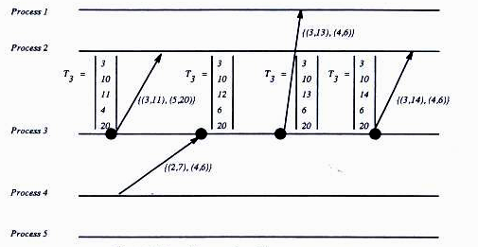
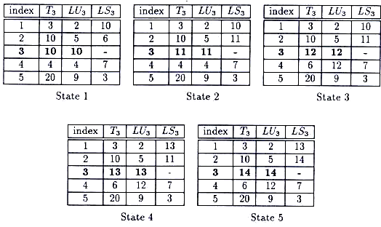
Singhal-Kshemkalyani’s VC example
when P₃ needs to send a message to P₂ (state 1), it only needs to send entries for P₃ and P₅

Slide 14
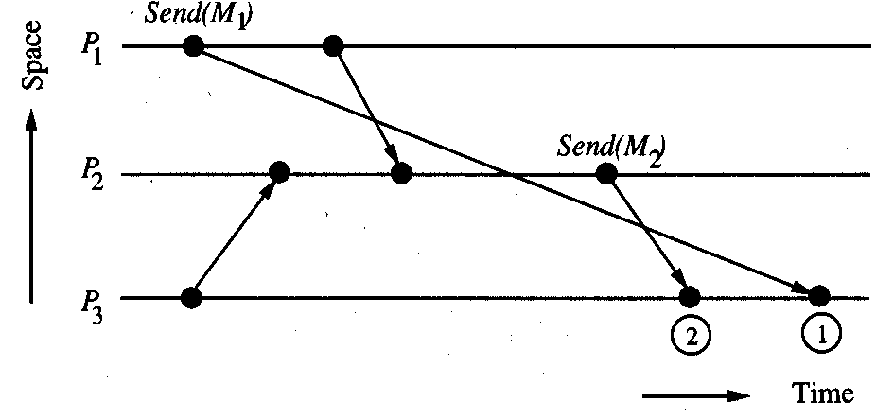
Application of VCs
causal ordering of messages
  maintaining the same
  causal order of message
  receive events
  as message sent
  that is: if Send (M1) → Send(M2) and Receive(M1) and Receive (M2) than Deliver(M1) → Deliver(M2)
  example above shows violation
  do not confuse with causal ordering of events
causal ordering is useful, for example in replicated databases or distributed state recording
two algorithms using VC
  Birman-Schiper-Stephenson (BSS) causal ordering of broadcasts
  Schiper-Eggli-Sandoz (SES) causal ordering of regular messages
basic idea – use VC to delay delivery of messages received out-of-order
Notes:
if a→b, then C(a)<C(b)
“Happened before” is only a partial order, since some pairs of events can have numerically identical timestamps
If we want to reason about events in a distributed system, this isn’t enough — we may need a total order
Any arbitrary relation, Lamport proposed one based on process ids
So we can totally order the events, but we’ve not really captured “happened before” any more

Slide 15
Birman-Schiper-Stephenson (BSS) causal ordering of broadcasts
non-FIFO channels allowed
each process P_{i} maintains vector time vt_{i} to track the order of broadcasts
before broadcasting message m, P_{i} increments vt_{i}[i] and appends vt_{i} to m (denoted vtm)
  only sends are timestamped
  notice that (vt_{i}[i]-1) is the number of messages from P_{i} preceding m
when P_{j} receives m from P_{i} ≠ P_{j} it delivers it only when
  vt_{j}[i] = vtm[i]-1 all previous messages from P_{i} are received by P_{j}
  vt_{j}[k] ≥ vtm[k], ∀k ∈{1,2,…n} but i
    P_{j} received all messages received by P_{i} before sending m
  undelivered messages are stored for later delivery
after delivery of m, vt_{j}[k] is updated according to VC rule R2 on the basis of vtm and delayed messages are reevaluated
Notes:
if a→b, then C(a)<C(b)
“Happened before” is only a partial order, since some pairs of events can have numerically identical timestamps
If we want to reason about events in a distributed system, this isn’t enough — we may need a total order
Any arbitrary relation, Lamport proposed one based on process ids
So we can totally order the events, but we’ve not really captured “happened before” any more

Slide 16
Schiper-Eggli-Sandoz (SES) Causal Ordering of Single Messages
non-FIFO channels allowed
each process P_{i} maintains V_{Pi} – a set of entries (P,t) where P a destination process and t is a VC timestamp
sending a message m from P₁ to P₂
  send a message with a current timestamp t_{P1} and V_{P1} from P₁ to P₂
  add (P₂, t_{P1}) to V_{P1} -- for future messages to carry
receiving this message
  message can be delivered if
    V_{m} does not contain an entry for P₂
    V_{m} contains entry (P₂,t) but t ≤ t_{P2} (where t_{P2} is current VC at P₂)
  after delivery
    insert entries from V_{m} into V_{P2} for every process P₃ ≠ P₂ if they are not there
    update the timestamp of corresponding entry in V_{P2} otherwise
    update VC of P₂
    deliver buffered messages if possible
Notes:
if a→b, then C(a)<C(b)
“Happened before” is only a partial order, since some pairs of events can have numerically identical timestamps
If we want to reason about events in a distributed system, this isn’t enough — we may need a total order
Any arbitrary relation, Lamport proposed one based on process ids
So we can totally order the events, but we’ve not really captured “happened before” any more

Slide 17
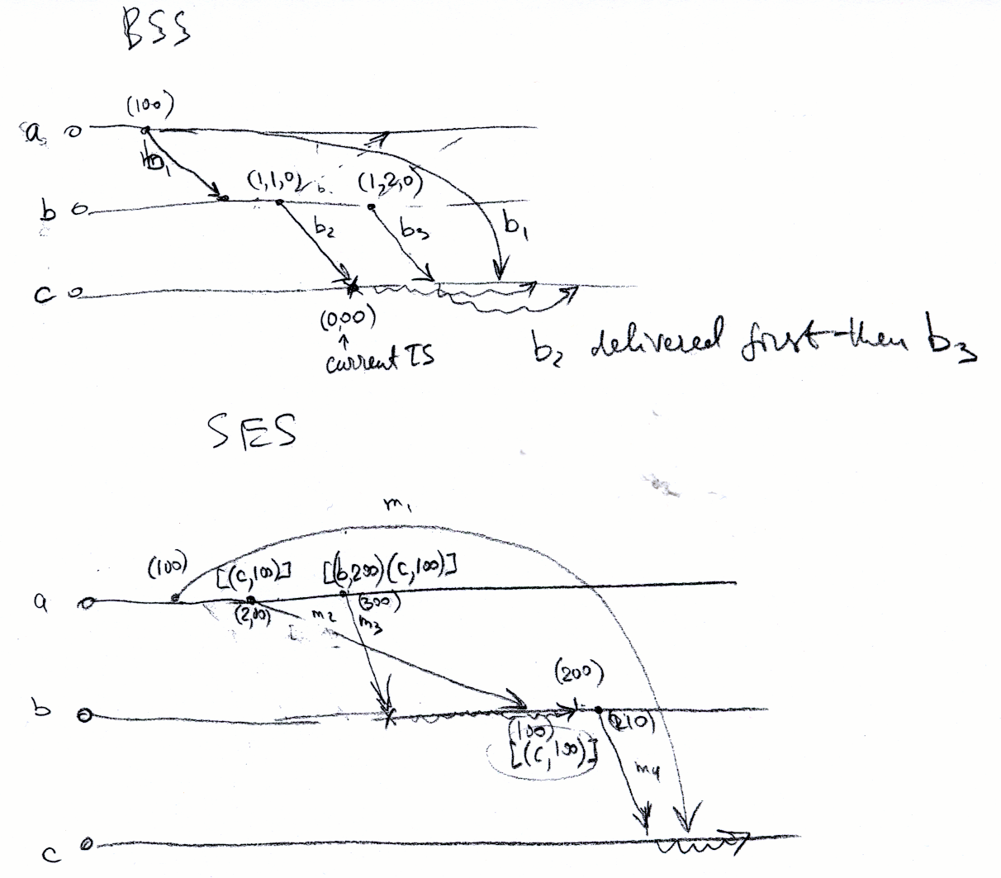
Example Computations of BSS and SES

Slide 18
Matrix Clocks
maintain an n×n matrix mt_{i} at each process P_{i}
interpretation
  mt_{i}[i,i] - local event counter
  mt_{i}[i,j] – latest info at P_{i} about counter of P_{j} . Note that row mt_{i}[i,*] is a vector clock of P_{i}
  mt_{i}[j,k] – latest knowledge at P_{i} about what P_{j} knows of counter of P_{k}
update rules
R1: before executing local event P_{i} update its own clock C_{i} as follows:
  mt_{i}[i,i] := mt_{i}[i,i] + d (d>0)
R2: attach the whole matrix to each outgoing message, when message received from P_{j} update matrix clock as follows
  mt_{i}[i,k] := max(mt_{i}[i,k], mt_{msg}[i,j]) for 1≤ k ≤ n – synchronize vector clocks of P_{i} and P_{j}
  mt_{i}[i,i] := max_{k}(mt_{i}[i,k]) – synchronize local counter
  mt_{i}[k,l] := max(mt_{i}[k,l], mt_{msg}[k,l]) for 1≤ k,l ≤ n – update the rest of info
  execute R1
basic property: if min_{k}(mt_{i}[k,i])>t then ∀k mt_{k}[k,i] >t that is, P_{i} knows that the counter of each process P_{k} progressed past k
  useful to delete obsolete info
Notes:
if a→b, then C(a)<C(b)
“Happened before” is only a partial order, since some pairs of events can have numerically identical timestamps
If we want to reason about events in a distributed system, this isn’t enough — we may need a total order
Any arbitrary relation, Lamport proposed one based on process ids
So we can totally order the events, but we’ve not really captured “happened before” any more

Slide 19
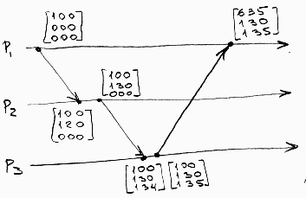
Example Computation of Matrix Clocks

